Slide 1
Formatted Files
A good way to store or load data using file handling, is to formatting files in a way both machines and human can read data files

Slide 2
Most used file formats
JSON
XML
JavaScript Object Notation is an open-standard file format that uses human-readable text to transmit data objects consisting of attribute-value pairs and array data types
Extensible Markup Language is a markup language that defines a set of rules for encoding documents in a format that is both human-readable and machine-readable.

Slide 3
JSON
Examples
XML
{
"id": 1,
"name": "Foo",
"price": 123,
"tags": [
"Bar",
"Eek"
],
"stock": {
"warehouse": 300,
"retail": 20
}
}
<note> <to>Tove</to> <from>Jani</from> <heading>Reminder</heading> <body>Don't forget me this weekend!</body> </note>

Slide 4
Java doesn’t have any premade json utility library by default. You should either create such utility by yourself or use an external library
JSON
Click to download an external library
Click for more tutorials

Slide 5
Lets dive into code and build a simple Json parser and formatter

Slide 6
Tips on how to write a beautiful code!!!

Slide 7
Tip #1
Follow the single responsibility principle
a part of SOLID principle

Slide 8
Tip #2
Write code that expresses intent

Slide 9
Tip #3
Use meaningful names

Slide 10
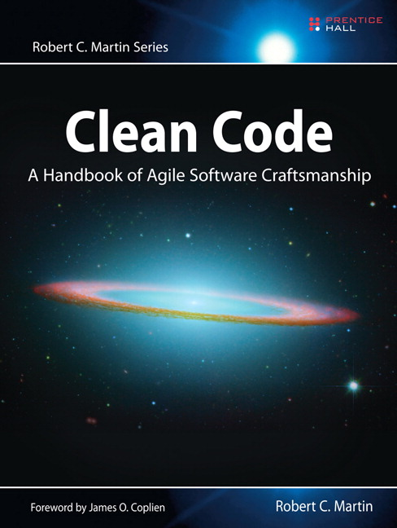
Writing clean code is just following a bunch of rules
To completely aware of those rules please read this book

